Slide 1

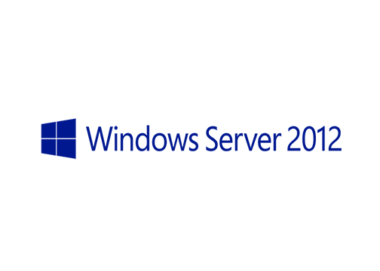
MegaSeries
Introduction to IPAM

Slide 2
General
New to Windows Server 2012
Is a free solution with which you can manage IP address blocks, DHCP scopes and DNS entries
Easy to set up and manage as it is integrated in the Server Manager

Slide 3
IPAM Functions
Address space management
Network discovery
Multi-server management
Audit

Slide 4
Important terms
Address block – This is just a container for a big block of IPs from which we can then create ranges; usually blocks are well knows IP nets like 172.16.0.0/16
Address range – This is a subset of a block which can be represented by a DHCP scope or an IPAM managed address range; An example: 172.16.0.1-172.16.0.100 as a DHCP scope

Slide 5
More on IPAM
It is completely agentless
Most of its tasks are done with scripts that run as Scheduled Tasks
Can manage Windows Server 2008+ as OS and DC, DNS, DHCP and NPS as server roles
Data can be imported and exported with the GUI and with Powershell which also permits integration with other system
The IPAM server has local groups with which you can grant users different roles in IPAM

Slide 6
https://www.youtube.com/channel/UCcZ-jLbPwNr8E_v9-65n8Iw https://github.com/itknowledge4

